Slide 1
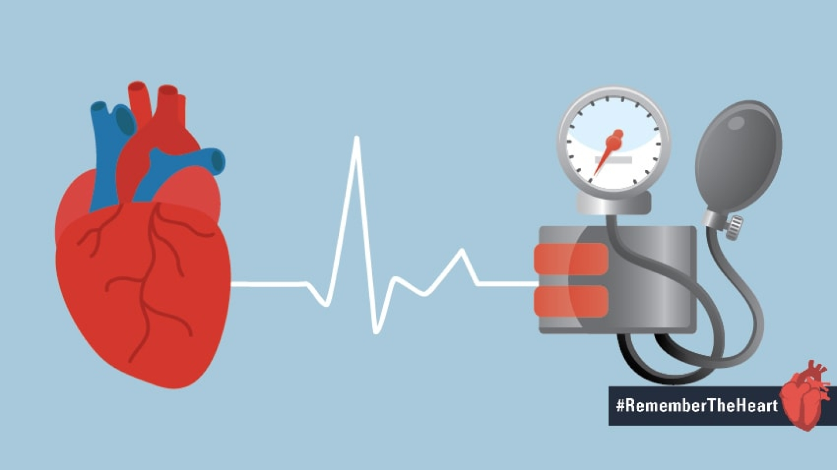
Hypertension management in patients with cardiovascular diseases
DR. Shahrokh Ezzatzadegan
Associate Professor of Medicine
Shiraz University of Medical Sciences

Slide 2
Outline
Coronary artery disease
Chronic heart failure
Previous stroke or transient ischemic Attack
Atrial fibrillation
Aortic valve stenosis

Slide 3
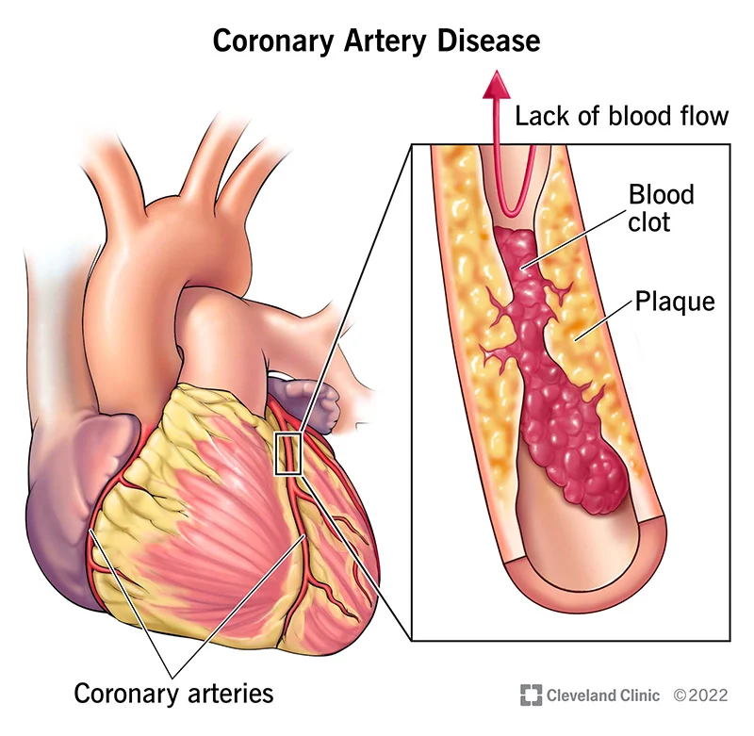
Coronary Artery Disease

Slide 4
Coronary Artery Disease
20% of myocardial infarctions are attributable to hypertension.
Every 10 mmHg reduction in office SBP reduced the risk by 17%.

Slide 5

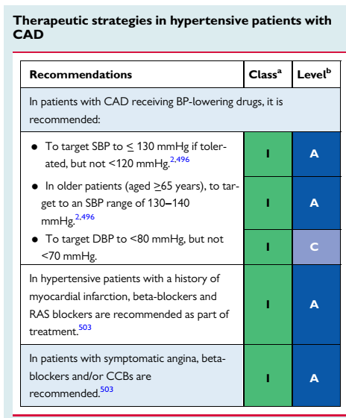

Slide 6
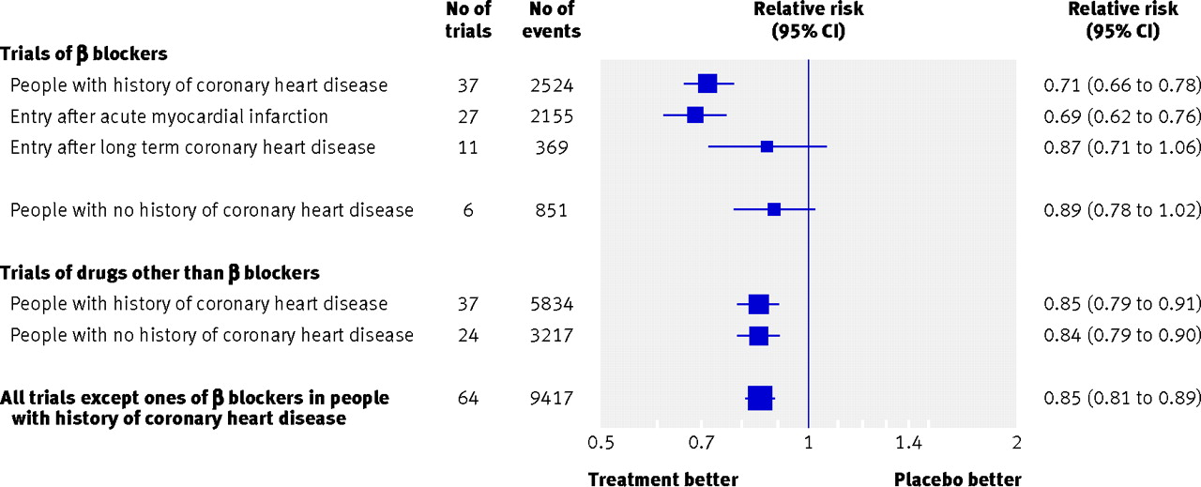

Relative risk estimates of coronary heart disease events in single drug blood pressure difference trials according to drug (β blockers or other), presence of CHD, and for β blockers according to acute myocardial infarction on entry.
After myocardial infarction, BB (except atenolol) reduced the risk of recurrent coronary artery disease events by 31%.
M R Law et al. BMJ 2009;338:bmj.b1665
©2009 by British Medical Journal Publishing Group
Notes:
Fig 1 Relative risk estimates of coronary heart disease events in single drug blood pressure difference trials according to drug (β blockers or other), presence of CHD, and for β blockers according to acute myocardial infarction on entry. (Totals are less than the sum of the individual categories because some trials include more than one category; see web extra figures 1a-e for individual trial results and summary estimates)‏

Slide 7

Antihypertensive treatment in CAD
RAS blockers
↓CV mortality
Beta-blockers
↓ the risk of recurrent CAD
CCBs
For symptom relief

Slide 8
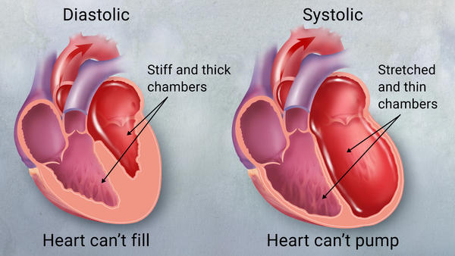
Chronic heart failure

Slide 9
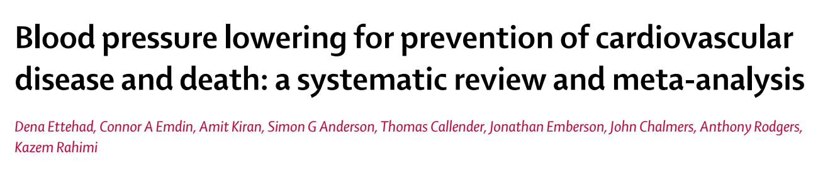
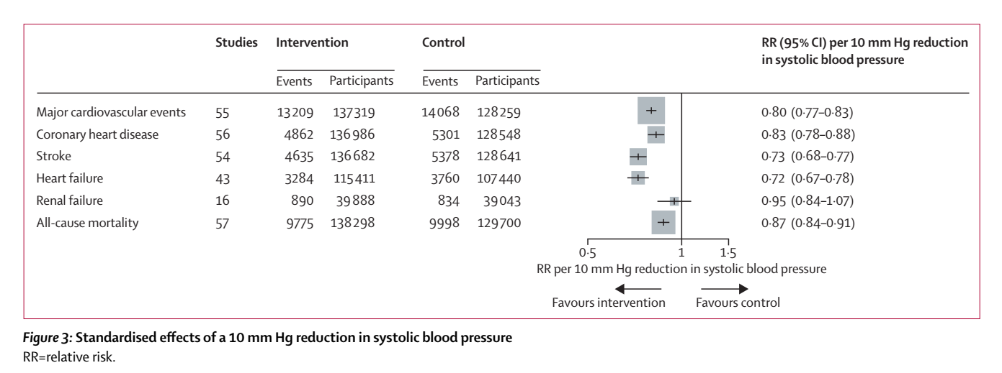
a 10 mmHg reduction in office SBP was associated with a decrease in relative risk of HF by 28%.
Blood pressure lowering for prevention of cardiovascular disease and death: a systematic review and meta-analysis. The Lancet. 2016;387(10022):957-67.

Slide 10
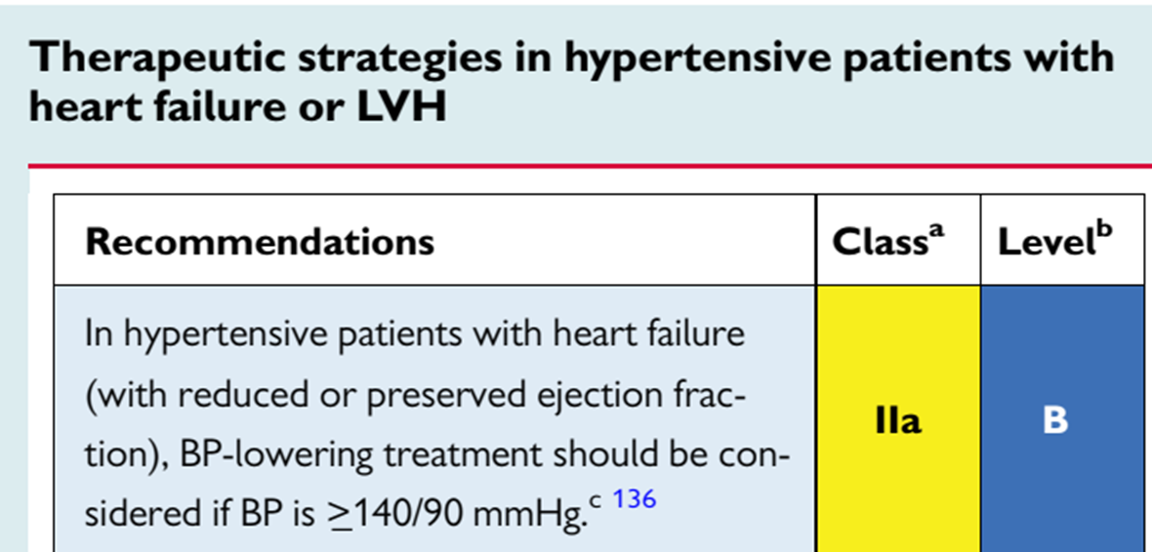
European Heart Journal. 2018;39(33):3021-104.

Slide 11
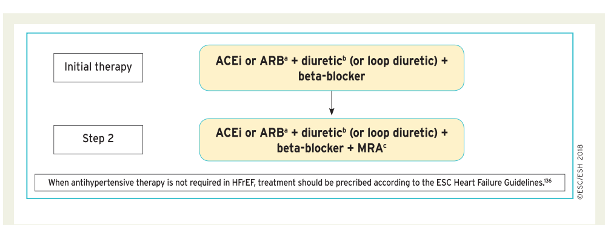
Drug treatment strategy for hypertension and hear failure with reduced ejection fraction
European Heart Journal. 2018;39(33):3021-104.

Slide 12
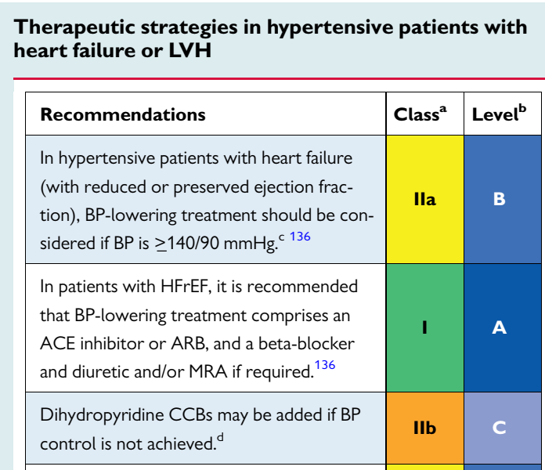
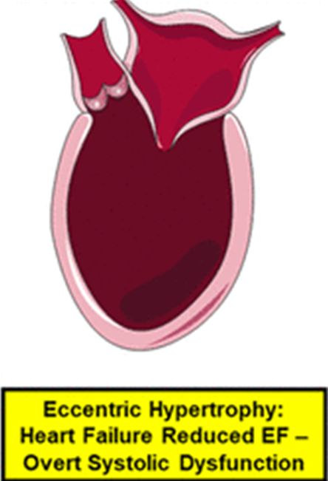

Slide 13
Antihypertensive treatment in HFrEF
RAS blockers
↑CO, ↓ congestive symptoms, ↓CV mortality
Diuretics
For signs of fluid overload
Beta-blockers
Improve survival (Carvedilol in particular)
MRA
Improve survival
CCBs
Amlodipine & felodipine are safe but neutral on survival.
CCB (diltiazem and verapamil) were associated with worse outcomes.

Slide 14

RAS inhibitors and kidneys in HFrEF
Generally do not improve kidney function.
Not generally need to be discontinued unless there is an increase in plasma creatinine that exceeds 30 to 35 percent from baseline.
There is a rise in creatinine most likely in patients on high-dose diuretic therapy.

Slide 15

Combination angiotensin receptor-neprilysin inhibitors
Sacubitril/valsartan (200 or 400 mg daily) reduced SBP and DBP more pronounced than valsartan.
Are generally preferred in place of an ACE inhibitor or ARB in patients who have symptomatic HF and reduced EF.
European Heart Journal (2022) 00, 1–19

Slide 16
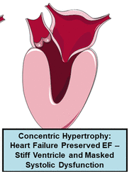
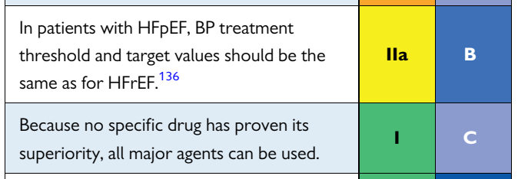
Heart failure with preserved ejection fraction
Lowering BP improves diastolic dysfunction, irrespective of the type of antihypertensive treatment used.

Slide 17
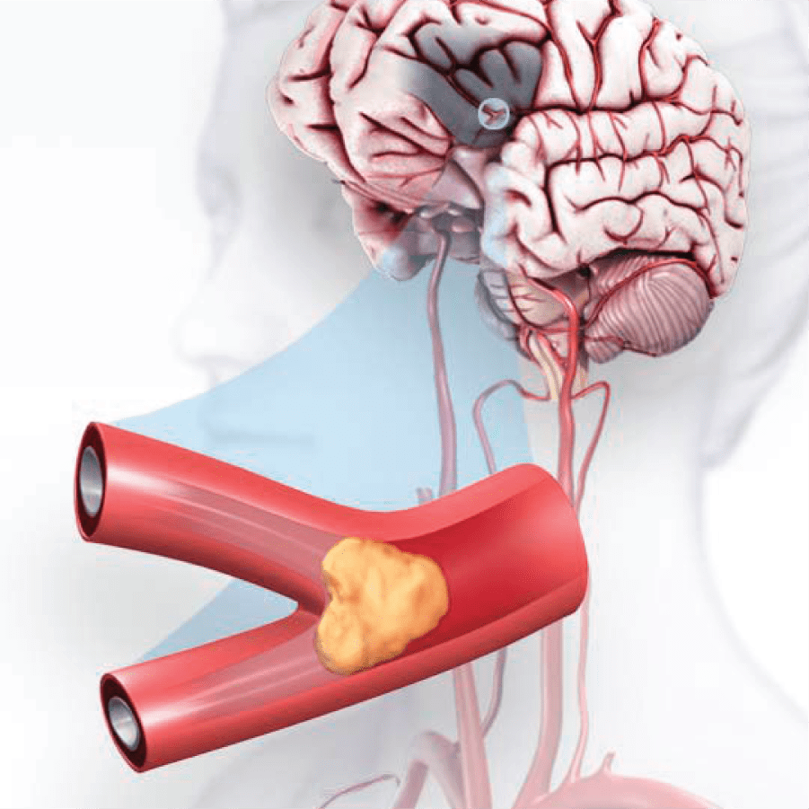
Stroke or Transient Ischemic Attack

Slide 18
Previous stroke or TIA
1
Hypertension is the most prevalent modifiable risk factor for haemorrhagic and ischaemic stroke.
2
About 70% of patients with a stroke have a history of hypertension.
3
Hypertension predicts stroke recurrence, and BP reduction reduces risks for recurrent stroke.

Slide 19

Williams B, et al. 2018 ESC/ESH Guidelines for the management of arterial hypertension. European Heart Journal. 2018;39(33):3021-104.

Slide 20

Were inferior to other antihypertensive drugs for stroke prevention.
Antihypertensive treatment should not include BB unless there is a cardiac indication.

Slide 21


Antihypertensive treatment in TIA and stroke
CCBs
Superior to RAS blockers and diuretics for stroke prevention
RAS blockers
Effective for stroke prevention
Diuretics
Effective for stroke prevention
Beta-blockers
Inferior to other antihypertensive drugs

Slide 22

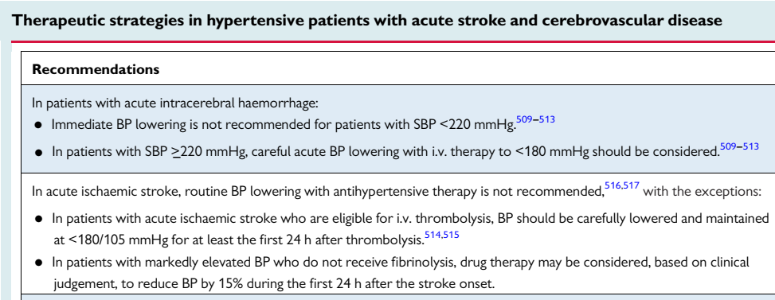
European Heart Journal. 2018;39(33):3021-104.

Slide 23
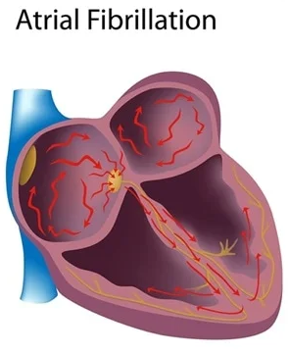
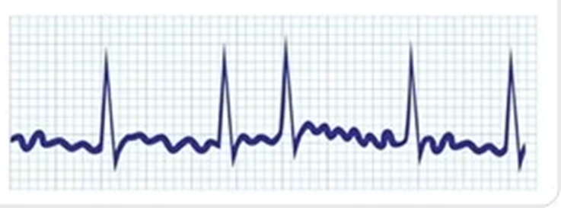

Slide 24
Hypertension in Atrial fibrillation
An important risk factor for AF.
The most important independent risk factor for stroke in patients with AF.
Uncontrolled hypertension is associated with an increased intracerebral bleeding risk with therapeutic anticoagulation.

Slide 25
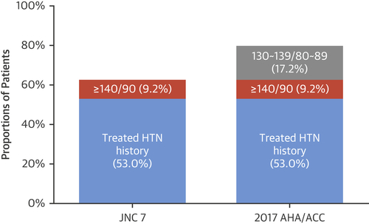

Prevalence of HTN Among Patients With AF Meeting the Definition for HTN According to the JNC7 Guideline and the 2017 ACC/AHA Guideline
Daehoon Kim et al. J Am Coll Cardiol 2018; 72:1233-1245.
Notes:
This study analyzed data for 298,374 Korean adults with oral anticoagulant–naive, nonvalvular AF obtained from the National Health Insurance Service database from 2005 to 2015.
Results:
According to the Seventh Report of the Joint National Committee on Prevention, Detection, Evaluation and Treatment of High Blood Pressure guideline, 62.2% of the individuals in our sample had hypertension. After applying the 2017 ACC/AHA guideline, 79.4% had hypertension, including 17.2% with newly redefined hypertension (130 to 139/80 to 89 mm Hg).

Slide 26
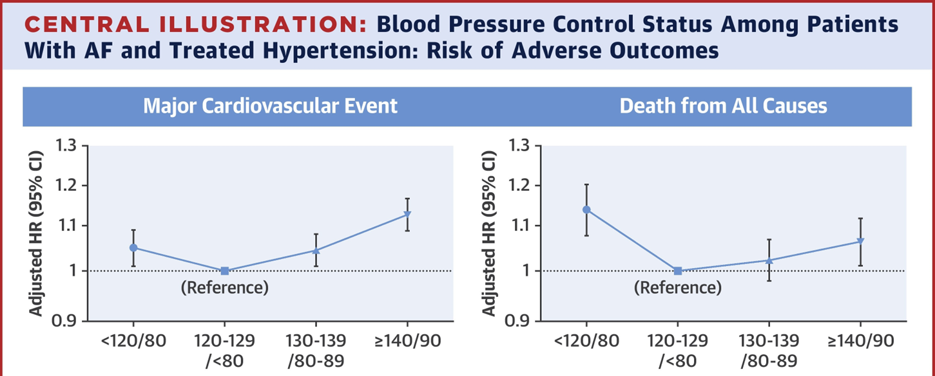
Blood Pressure Control Status Among Patients With AF and Treated Hypertension: Risk of Adverse Outcomes
The recommended treatment targets are 120–129 and <80 mmHg.
Daehoon Kim et al. J Am Coll Cardiol 2018; 72:1233-1245.

Slide 27
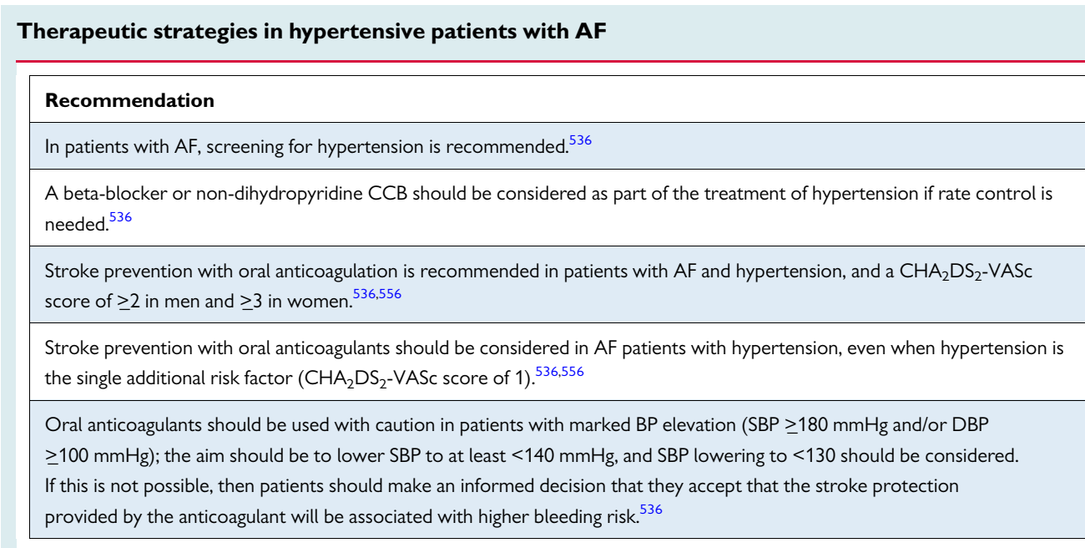
In normal EF, non-dihydropyridine CCB (e.g. verapamil or diltiazem) can be considered for BP and rate control if BBs are contraindicated or not tolerated.

Slide 28
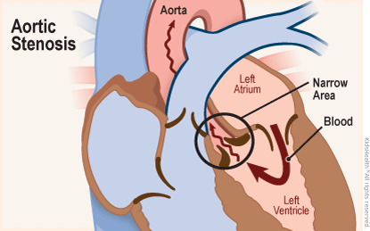

Slide 29
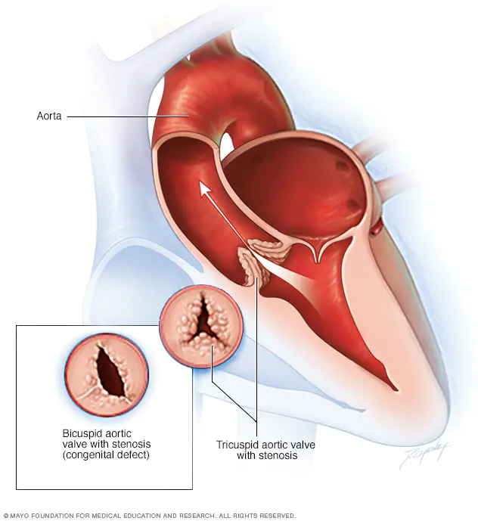
Aortic valve stenosis
Hypertension coexists in ∼70% of the patients with aortic valve stenosis.
Evidence exists that hypertension promotes the progression and exaggerate symptoms of aortic valve disease.

Slide 30
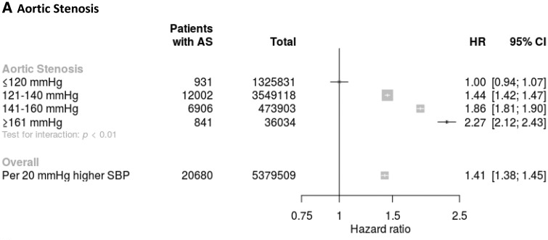
High BP and risk of Aortic valve stenosis
In 5.4 million patients without known CV disease, long-term exposure to elevated BP (median follow-up of 9.2 years) was associated with an increased risk of aortic valve stenosis and regurgitation.

Slide 31
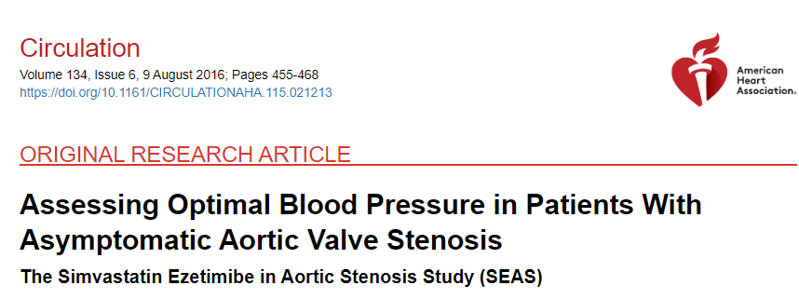
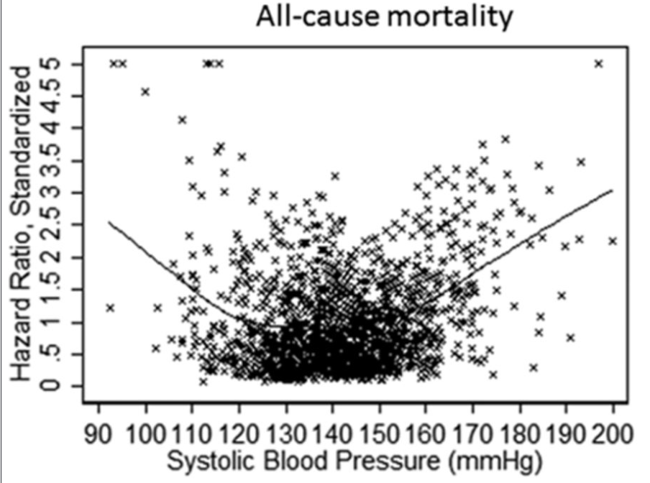

Nielsen, O. W., et al. (2016)." Circulation 134(6): 455-468.

Slide 32
Antihypertensive treatment in AS
Careful drug titration is recommended to avoid hypotension.
RAS blockers
Safe and effective
Beta-blockers
Safe and may improve survival.
CCBs
Cannot be recommended as no studies exist on their long-term use.

Slide 33
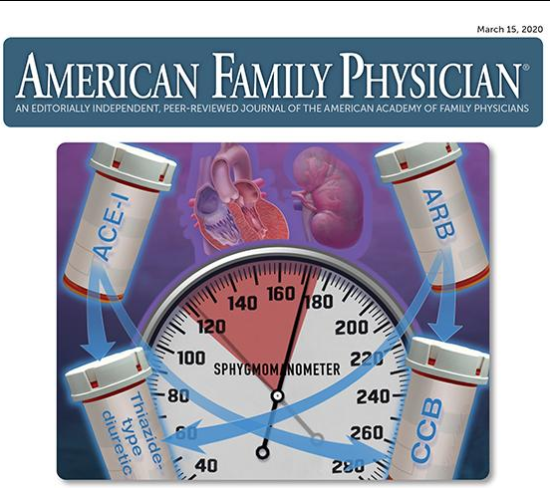
Combination Therapy in Hypertension Management
Dr. Shahrokh Ezzatzadegan
Shiraz University of Medical Sciences

Slide 34
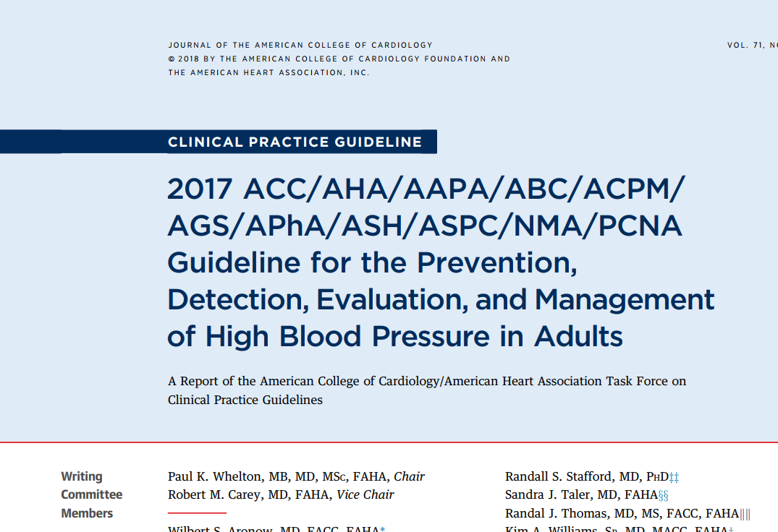
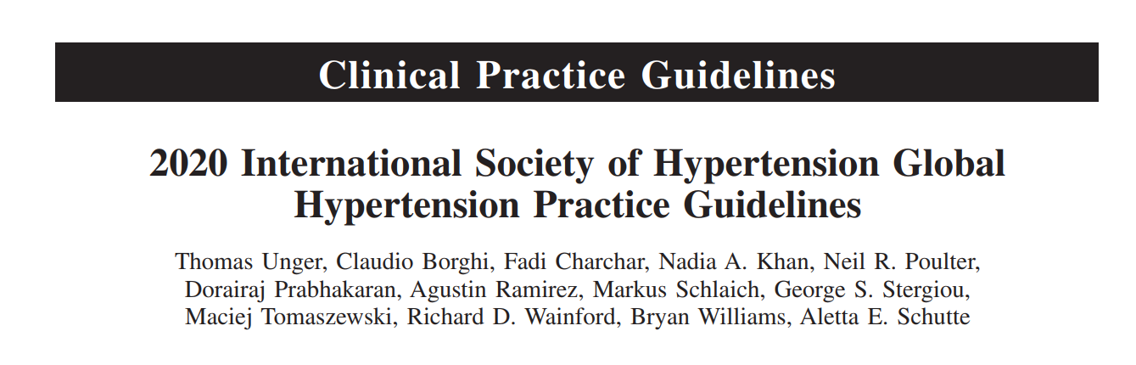
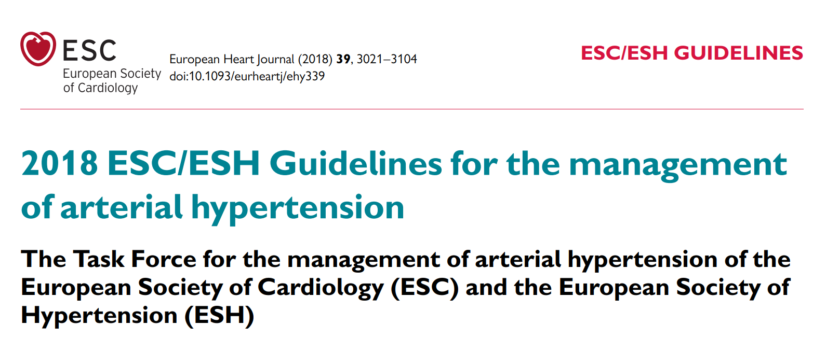
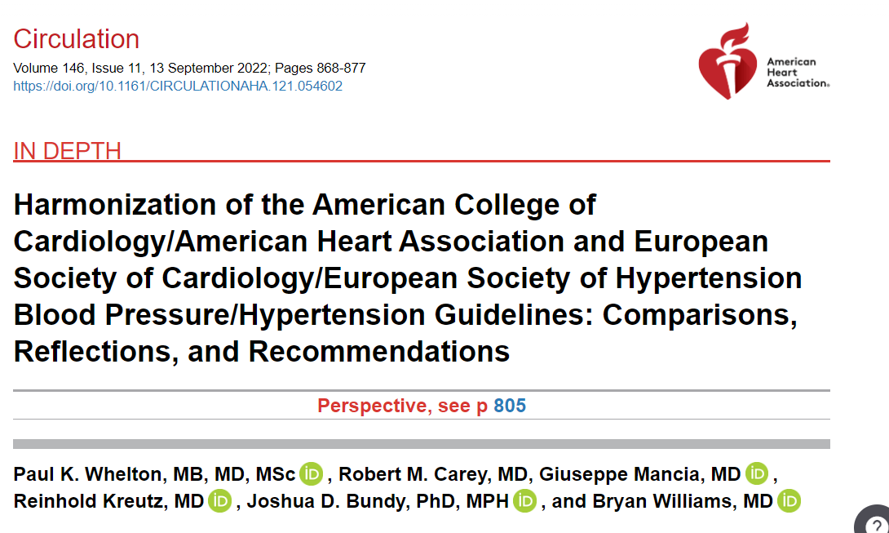

Slide 35
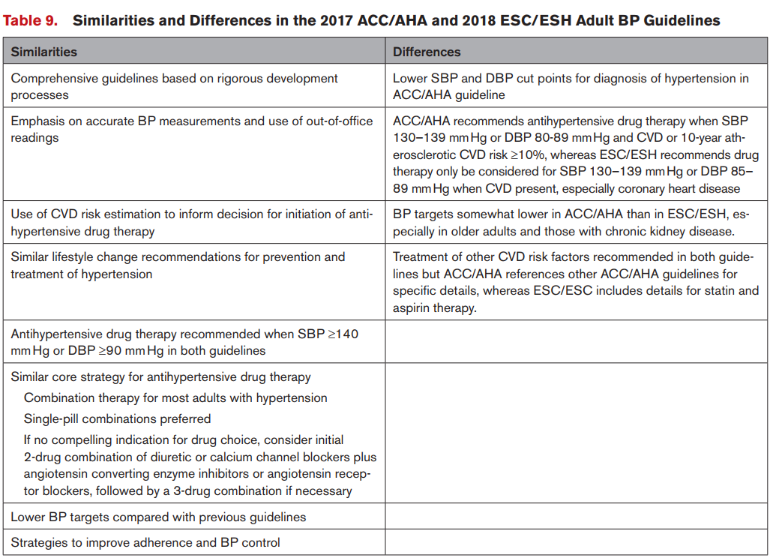

Slide 36

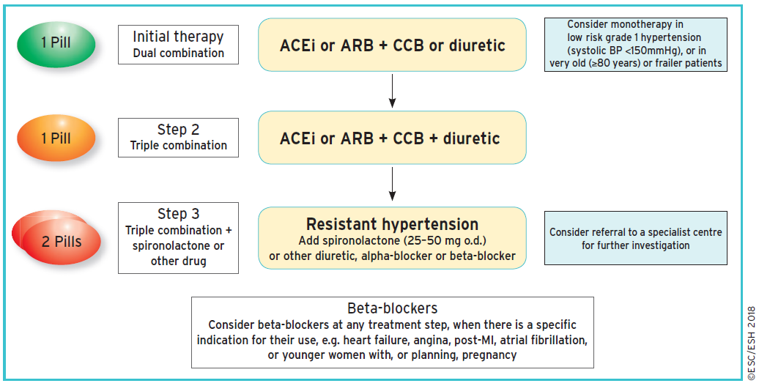
The core algorithm is also appropriate for most patients with HMOD, cerebrovascular disease, diabetes, or PAD.
Eur Heart J. 2018 ;39:3021-3104.
ACEi = angiotensin-converting enzyme inhibitor; ARB = angiotensin receptor blocker; CCB =calcium channel blocker; HMOD = hypertension-mediated organ damage; MI = myocardial infarction; o.d. = omni die (every day); PAD = peripheral artery disease.

Slide 37






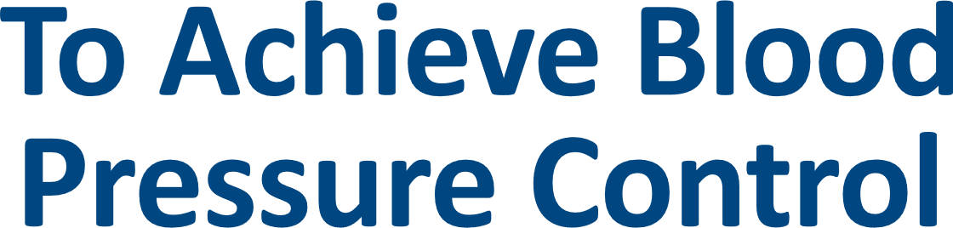
Vasc Health Risk Manag 2010; 6: 321–325

Slide 38


Up to 39% medication adherence with single pill combination versus free combination of antihypertensive medication
Up to 39%
RX
SPC
Meta- analysis of 62, 481 patients with hypertension, with 30, 103 patients taking single pill combinations and 32, 378 patients taking free-equivalent combinations.
J Clin Hypertens. 2018;20:902–907.

Slide 39




Situation: Nonadherence in patients with hypertension
1 Pill
2 Pill
3 Pill
<10%
~20%
~40%
Treatment adherence is strongly influenced by the pill
number and frequency
Vasc Health Risk Manag. 2010 ;6:321-325, J Hypertens. 2011;29:610-618, BMJ Open. 2019 ;9:e023995.

Slide 40
Combination versus Monotherapy and Sequential Up-titration

Slide 41
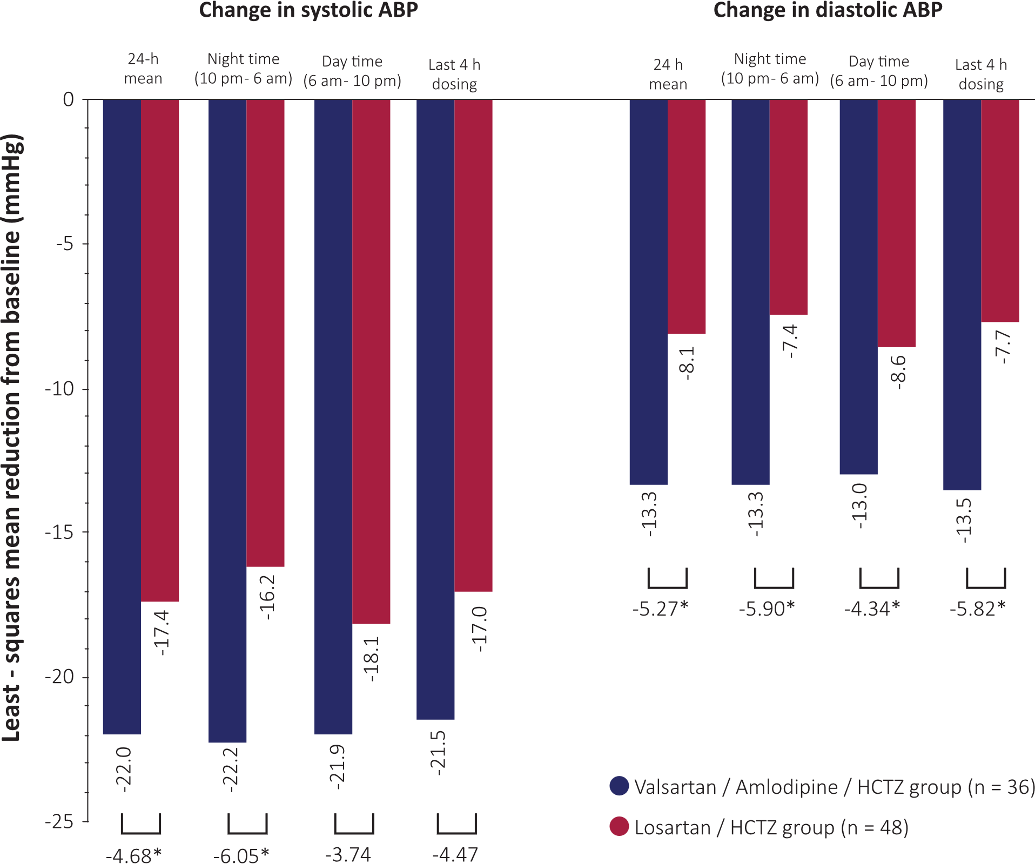
Moderate doses of ARB/CCB/ diuretic is more effective in lowering nighttime and daytime ABP than a maximal dose of an ARB with a diuretic
Mean reduction in mean ABP at week 6 were significantly greater in the valsartan/amlodipine/HCTZ group than in the losartan/ HCT group (-22.0 ±1.7/-13±1.0 versus -17.4±1.5/ -8.1±0.8 mmHg, P = 0.043/P < 0.001, respectively).
Vasc Health Risk Manag. 2011; 7: 701–708

Slide 42
Which Combination?
Single Pill Combination or
Free Combination and Outcome Results

Slide 43
Simplicity, better compliance and tolerability all together with single pill combination versus free combination
 | Free combination therapy | Single-pill combination therapy
Efficacy | ++ | ++
Time to reach BP target | ++ | ++
BP variability | + | +
Simplicity | - | +
Compliance | - | +
Tolerability | + | ++
Comparison between different HTN management strategies
Adapted from Integr Blood Press Control. 2013; 6:69-78, Hypertension. 2021;77:692–705

Slide 44
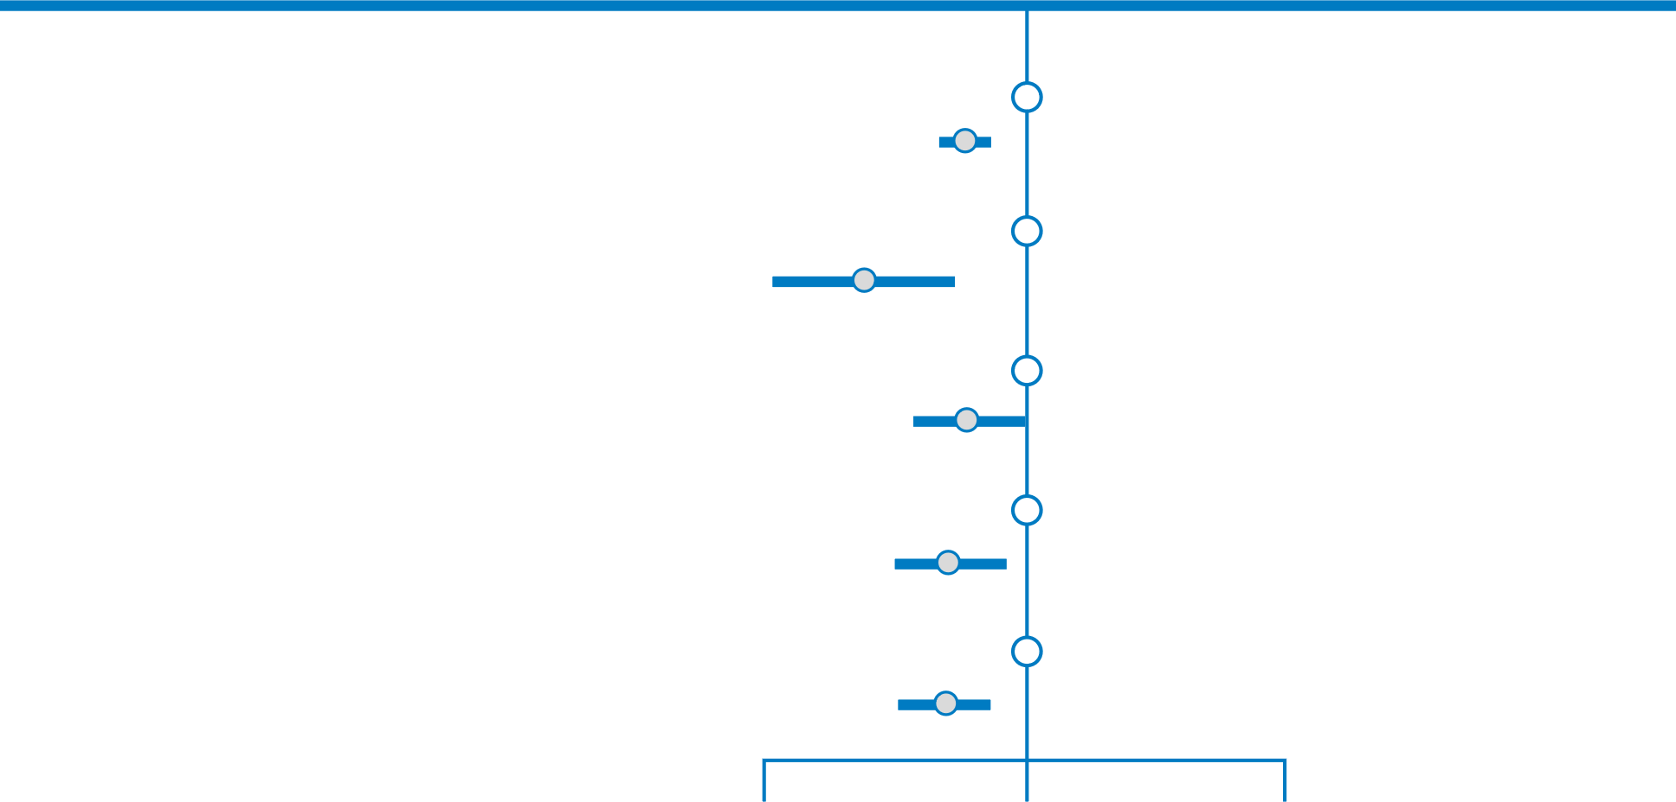
Hospitalization risk for cardiovascular events was lower with initial 2-drug single pill combination versus monotherapy
Outcome
Treatment strategy
HR (95% CI)
p
Any CV events
Monotherapy
Combination therapy
1.00 (Ref)
0.84 (0.79-0.90)
<0.001
Heart failure
Monotherapy
Combination therapy
1.00 (Ref)
0.65 (0.51-0.82)
<0.001
Cerebrovascular
disease
1.00 (Ref)
0.85 (0.74-0.98)
Monotherapy
Combination therapy
0.027
Ischemic heart
disease
Monotherapy
Combination therapy
1.00 (Ref)
0.80 (0.71-0.91)
<0.001
Death
Monotherapy
Combination therapy
1.00 (Ref)
0.80 (0.72-0.89)
<0.001
0.5
1
2
Hazard ratios (HR) and 95% CI estimating the risk of cardiovascular (CV) outcomes and death between patients with
initial antihypertensive monotherapy and initial 2-drug single pill combination therapy.
During 3-year follow-up of 19627 patients, significant reduction in the risk of hospitalization for all considered outcomes displayed
in patients prescribed an initial single pill 2-drug combination vs. patients with initial monotherapy and remaining on monotherapy.
The risk reduction was largest for heart failure.
Circ Res. 2019;124:1113–1123, Hypertension. 2018;72:846-853

Slide 45
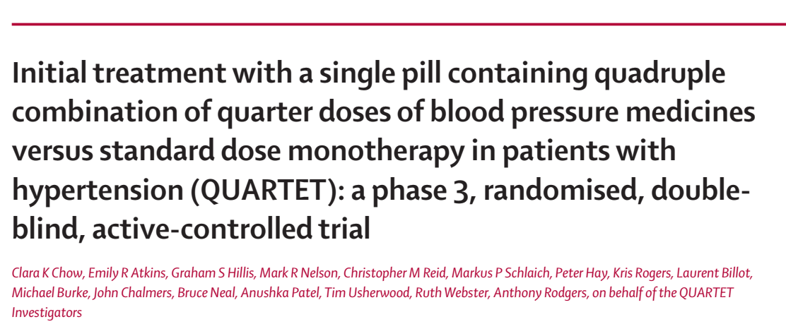
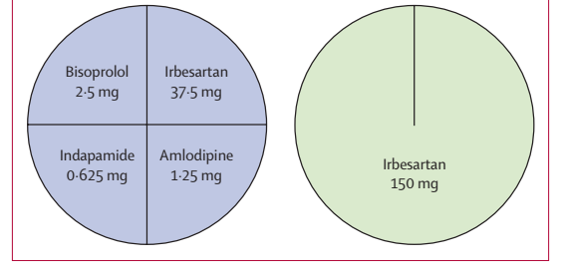


Slide 46
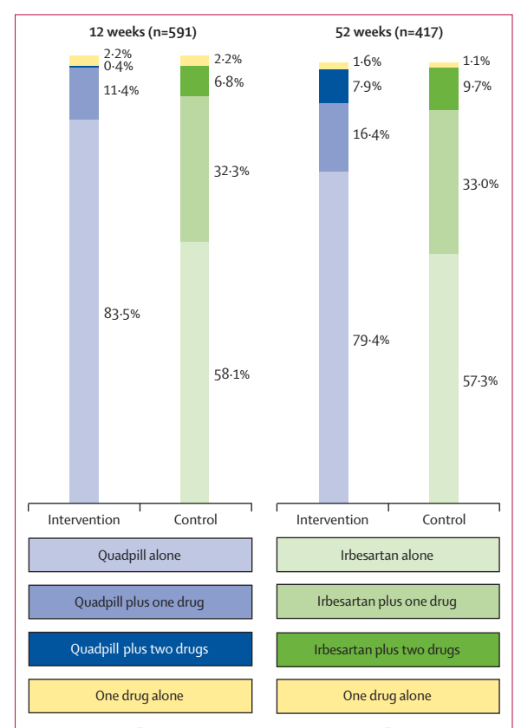
Blood pressure-lowering treatment at 12 weeks and 52 weeks in intervention and control groups

Slide 47
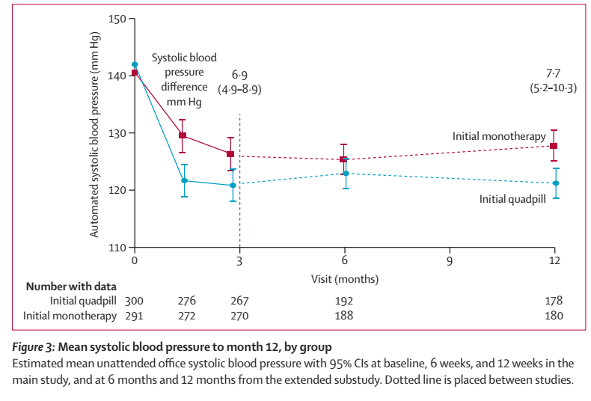

Slide 48
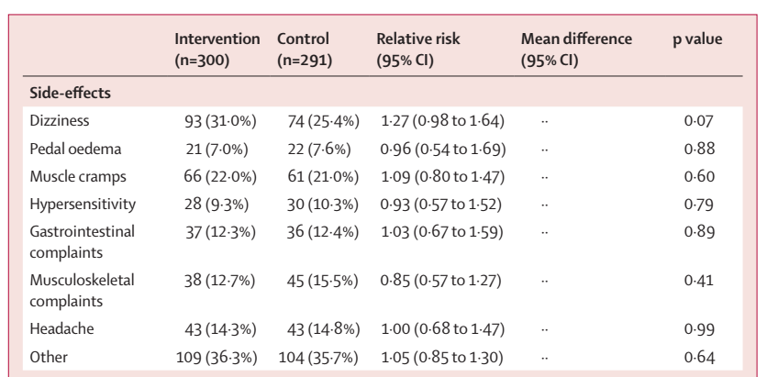
Early treatment of a fixed-dose quadruple quarter-dose combination achieved and maintained greater blood pressure lowering compared with the common strategy of starting monotherapy.
This trial demonstrated the efficacy, tolerability, and simplicity of a quadpill-based strategy.
Tolerability at 12 weeks

Slide 49
Free equivalents rather than a single-pill combination
1
In patients with a history of multiple drug allergies or intolerances
  starting with one drug and then adding a second agent several weeks later makes it less complicated
2
Complex cases of hypertension
ie, patients with renovascular or other secondary forms of hypertension
because they are simpler to titrate when frequent dose adjustment is needed,
  In each of these settings, the free equivalents can eventually be replaced by a single-pill combination once the blood pressure is controlled and the patient is tolerating therapy.

Slide 50
MONOTHERAPY: WHEN, WHY, WHICH CLASS?

Slide 51

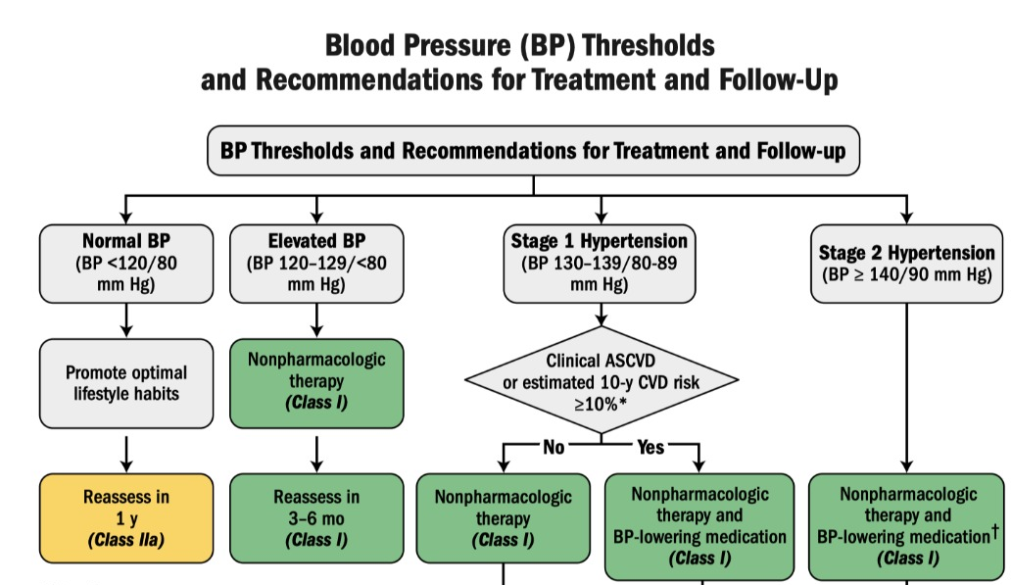

Slide 52
Treatment of stage 1 hypertension even in low-risk patients has CV benefits
25-70%
Higher CVD event rates with untreated stage 1 hypertension at baseline compared with those with a normal BP.
60%
Majority of stage 1 hypertension will progress to stage 2 hypertension, with higher risk of ASCVD.
JAMA. 2018;320:1783–1792.
Hypertension. 2021;77:e58-e67.

Slide 53
When to initiate treatment with one drug (monotherapy)
Stage 1 hypertension (SBP 130 to 139 mmhg and/or DBP 80 to 89 mmhg)
For patients who are deemed to be at higher risk for adverse effects:
  Those adhering to a very low salt intake,
  Those who are underweight or frail,
  Those with a known orthostatic decline in blood pressure

Slide 54
ACE/ARBs
CCBs
Diuretics
The initial drug dose should generally be low
Exception:
ARBs
Their maximal antihypertensive effect is moderate in most patients.
Thus, initiation with a moderate to high dose of an ARB is reasonable because this prevents the need for unnecessary dose titration.
Clinical Therapeutics. 2004;26:A28-A32.

Slide 55
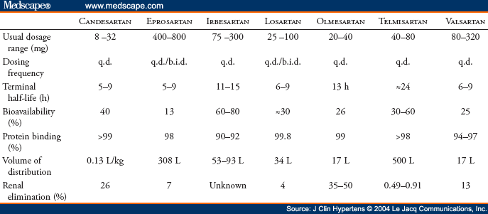

Slide 56
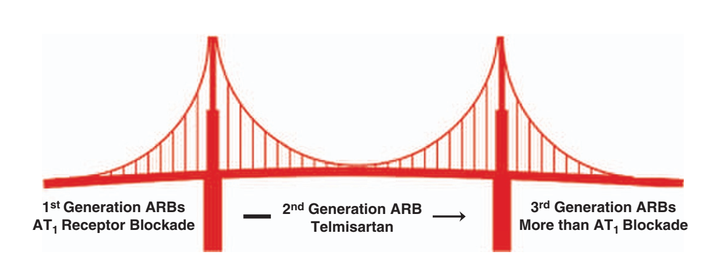
Next generation multifunctional angiotensin receptor blockers
Bridge to the future of next generation ARBs
Hypertension Research (2009) 32, 826–834

Slide 57
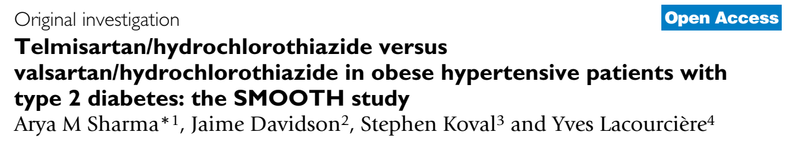
Cardiovascular Diabetology 2007, 6:28

Slide 58
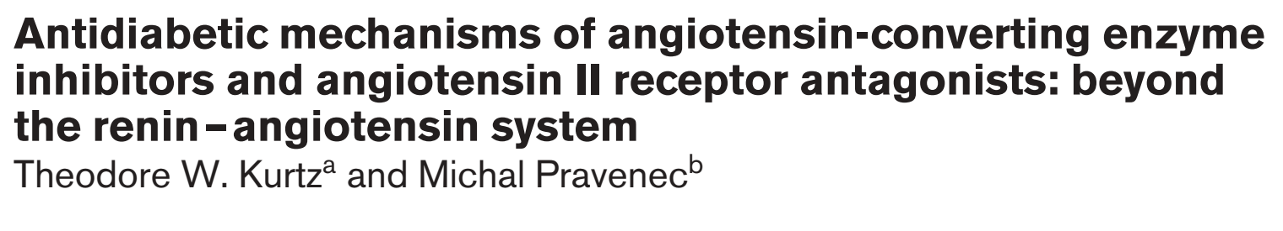
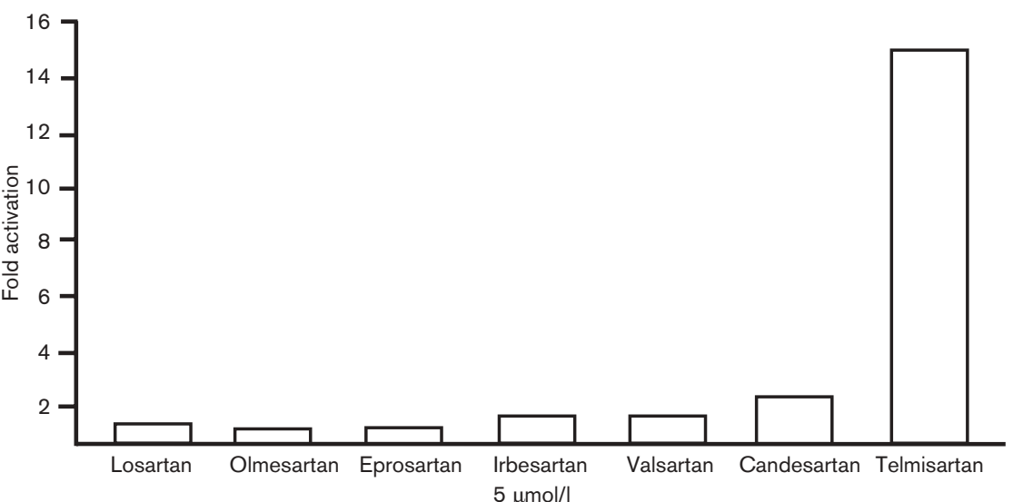
Comparison of the ability of ARBs to activate peroxisome proliferator activated receptor gamma (PPARª)
Journal of Hypertension 2004, Vol 22 No 12

Slide 59
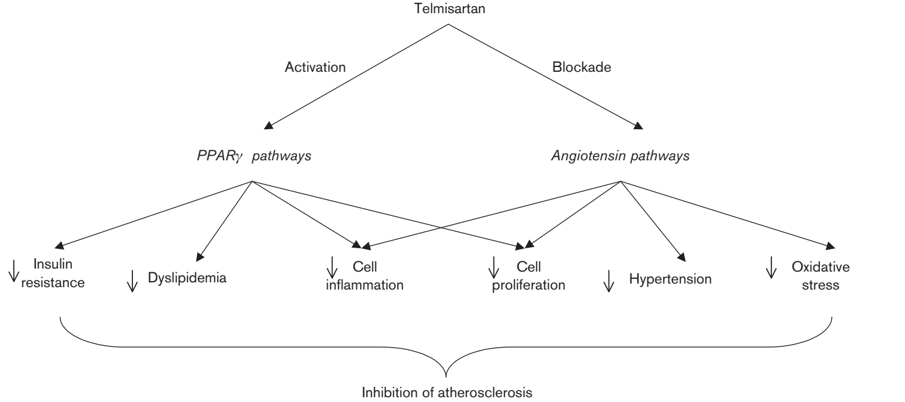
Potential influence of telmisartan on pathways that are likely primarily to mediate the anti-atherosclerotic effects of PPARª activation and angiotensin II receptor blockade
Journal of Hypertension 2004, Vol 22 No 12

Slide 60
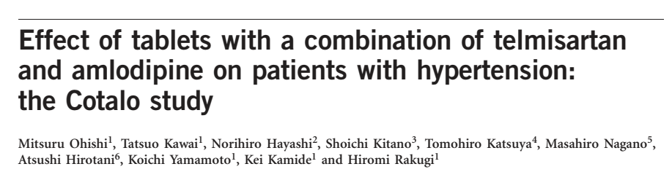
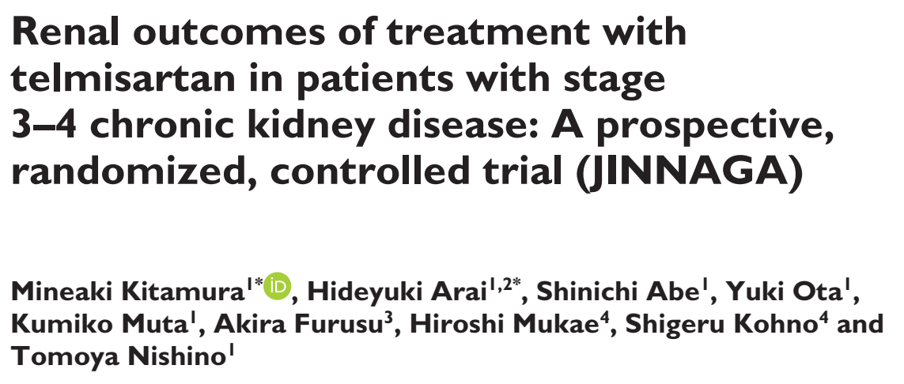
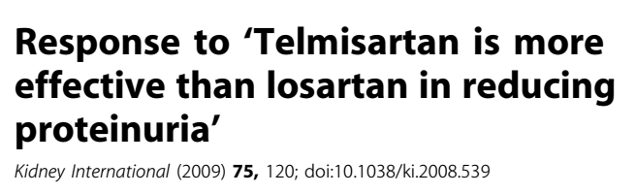

Slide 61

www.thelancet.com Vol 392 September 8, 2018

Slide 62
Take Home messages
Combination single pill is preferred for the treatment of most adults.
SPC significantly increases compliance.
The initial drug dose should generally be low except ARBs.
Telmisartan has the highest half life among ARBs and suitable for early morning BP surge and 24 hours coverage.

Slide 63

Thanks For Your Attention

